Slide 1

Implementation of a Memristor Based 4-Bit ALU
Ambika Acharya(12200321012)
Jhumur Bera(12200322058)
Priyanka Karmakar(12200321039)
Trisha Dutta(12200322061)
Under the supervision of Dr.Pravanjan Samanta
Group-13

Slide 2
Content
1
2
3
4
5
Introduction
Literature Survey
Project Description
Future Work & Utility
Conclusion

Slide 3
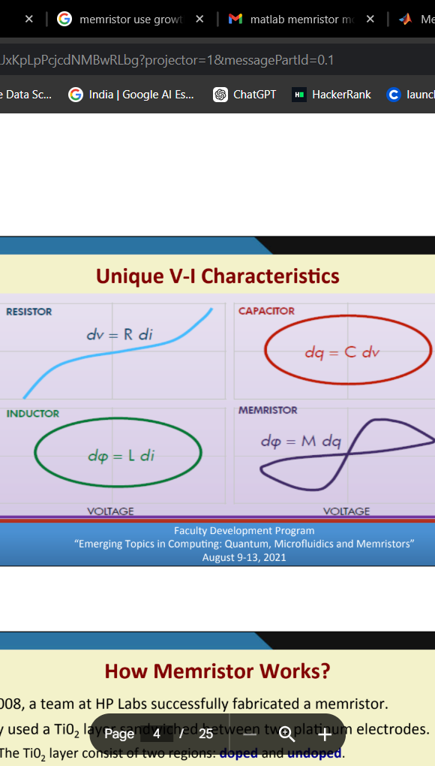
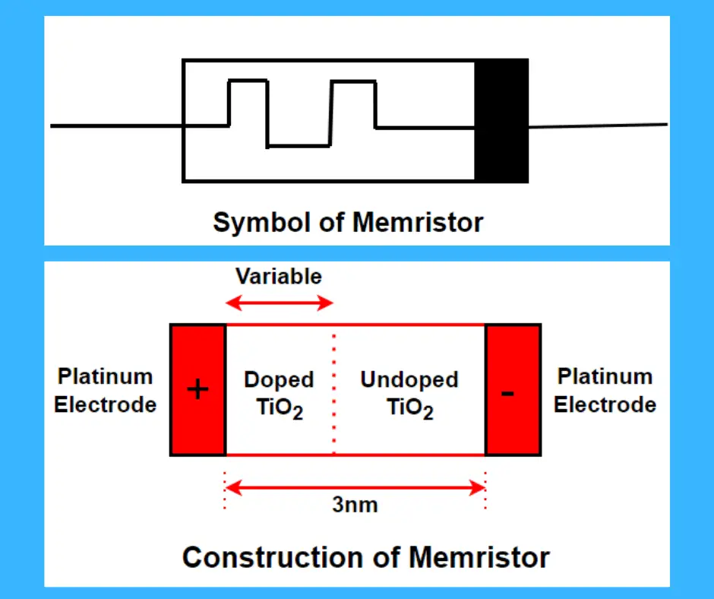
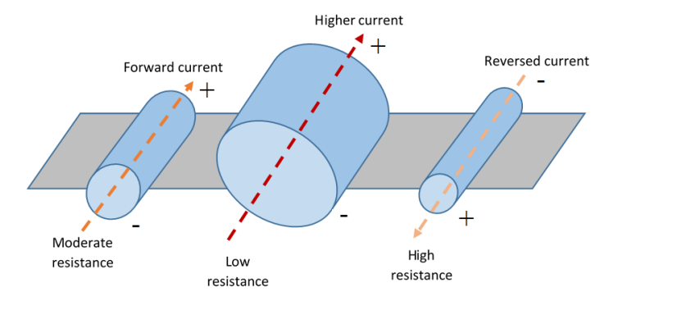
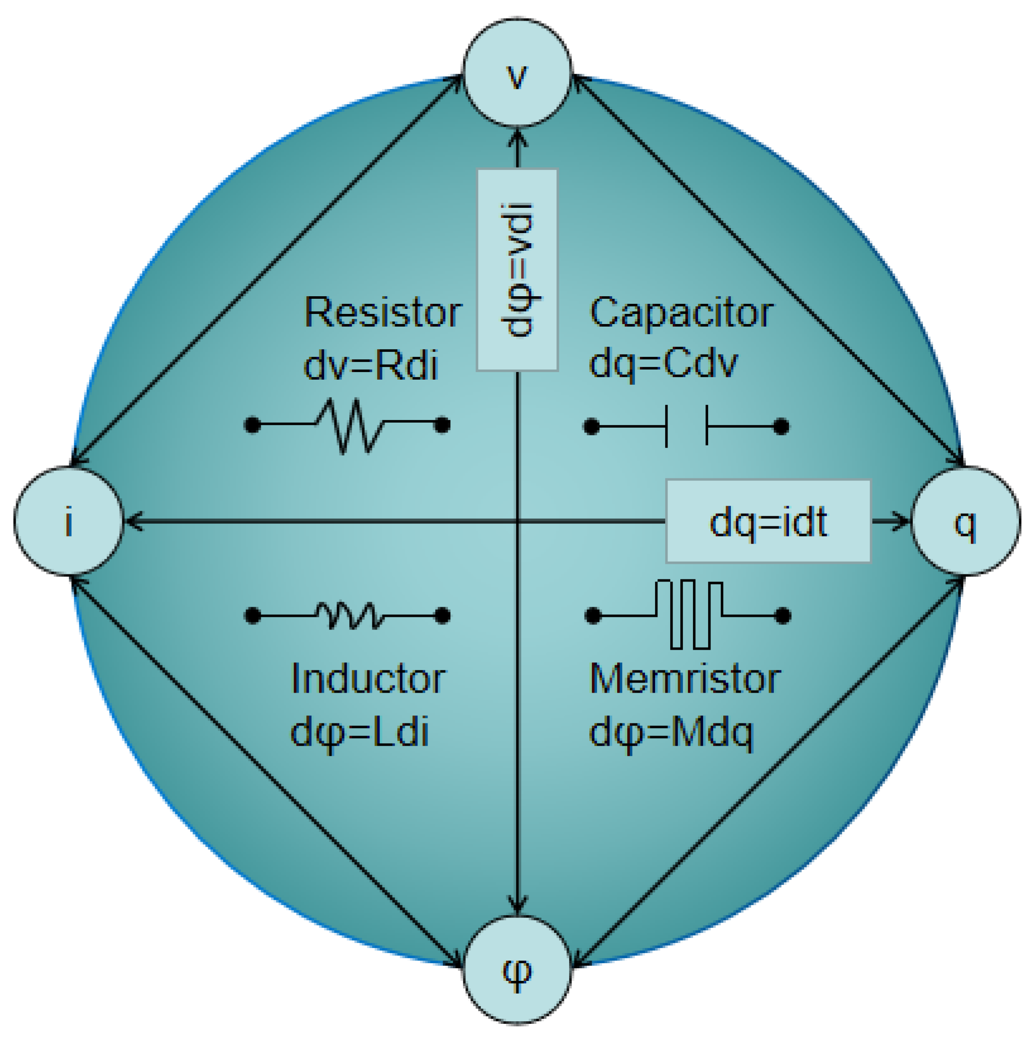
Introduction
1971: Prof. Leon Chua of UC Berkley postulates that the memristor is the
fourth fundamental circuit element.[1]
Pinched hysteresis loop v = M(x).i -> i=0 -> v=0 : zero crossing
“if it’s pinched, it’s a memristor” (L.Chua)

Slide 4
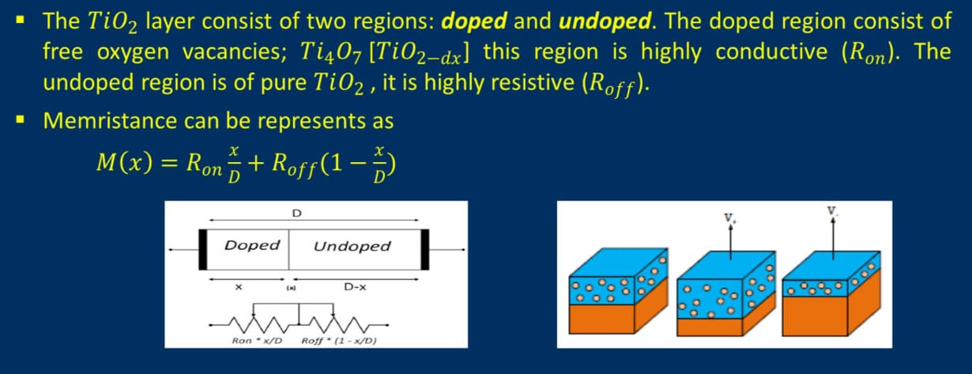
Working Principle of Memristor
[2]

Slide 5
Literature Survey
Leon Chua (1971)
Huang, G. M., Ho, Y., & Li, P. (2010)
Mohanty, S. P. (2013)
Mladenov & Kirilov (2015)
Memristor—The Missing Circuit Element.
IEEE - Transaction
Memristor System Properties and Its Design Applications
IEEE- Journal
Memristor: From Basics to Deployment.
IEEE- Potential
Memristor Modelling in MATLAB® & PSPICE®
IEEE- Conference
Shirin Zadeh et al. (2018)
Apollos, E. (2019)
Abdalla (2020)
Sahoo & Prabaharan, S. R. S. (2020)
Logic Design Using Memristors: An Emerging Technology
IEEE- Conference
Memristor Theory and Mathematical Modelling
IEEE- Journal
Memristor Operation and Applications
IEEE - Transaction
Memristor Equipped Arithmetic Logic Unit
IEEE- IC- GET

Slide 6

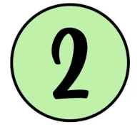

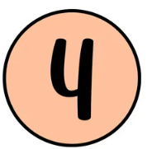

Comparative Study & Innovation
Device variability
Fix: Simulated random resistance values and used output averaging in Python to stabilize results.
Proper Hysteresis Curve
Fix: Implement an Ion based memristor model reflecting realistic operational curves.
Magic Logic Implementation
Fix: Implement Magic Logic of Memristor for various operations.
Error Analysis
Fix: Using Python Stimulator rather than LT-Spice or H-Spice reduce errors.
Lack of interactive interface
Fix: Built a Python based system, live inputs & output plots, and user define operation

Slide 7
“
Why Memristor & Why not CMOS?[3]
Aspect | Memristor-Based ALU | CMOS-Based ALU
Power Consumption | Very low (non-volatile) | High (leakage and switching losses)
Area Efficiency | Highly compact | Requires more space
Speed | Faster (in-memory computing) | Slower (separate memory and logic)
Data Retention | Retains data without power | Loses data when power is off
Scalability | Easily scalable (2-terminal devices) | Limited by transistor scaling
Design Complexity | Simpler logic implementation | Complex with more components
Energy Efficiency | Highly energy-efficient | Less efficient
ALU Suitability | Proven for efficient arithmetic and logic functions | Traditional but less optimized
”

Slide 8
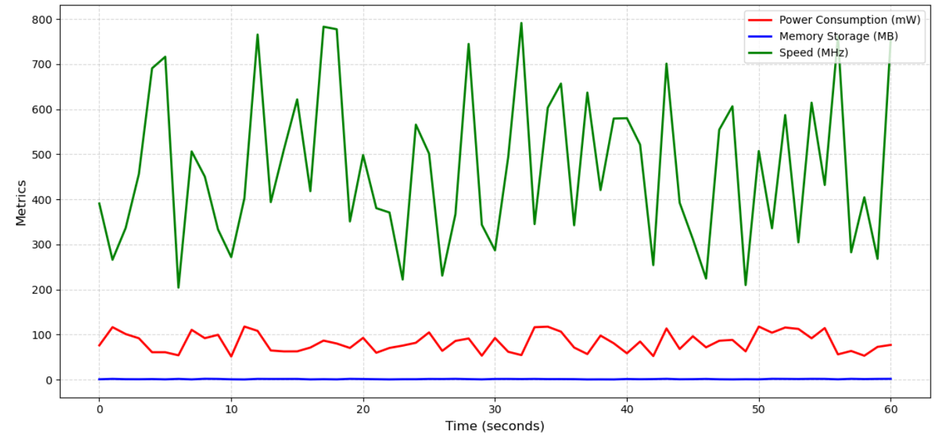
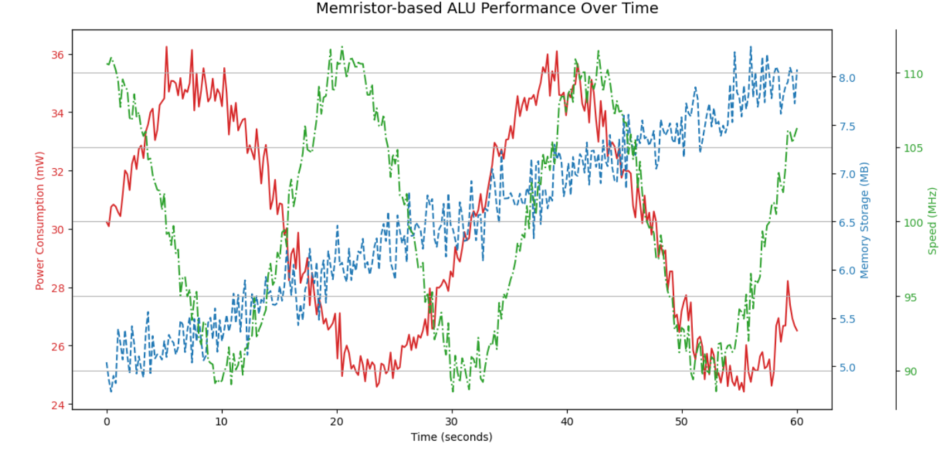
Graphical Comparison
(Power Consumption: 50-120 mW, Memory storage: 0.5-2 MB
Speed: 200–800 MHz)
(Power Consumption: 24-36 mW, Memory storage: 0.5-8 MB
Speed: 90-150 MHz)
CMOS Based ALU
Memristor Based ALU

Slide 9
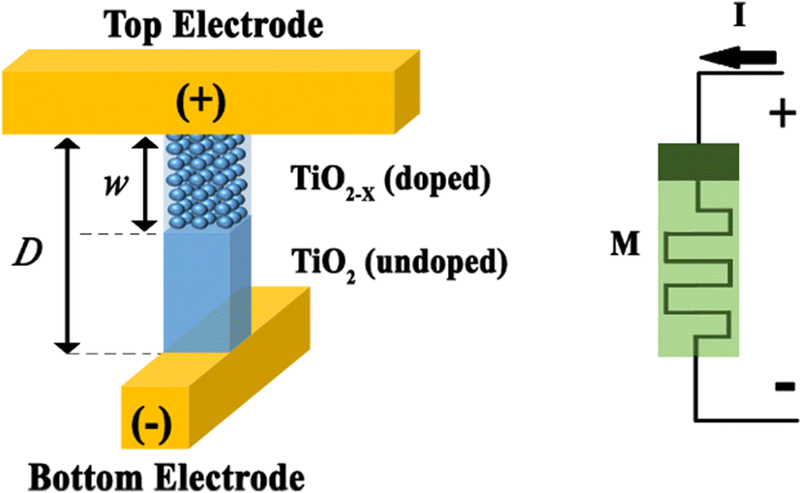
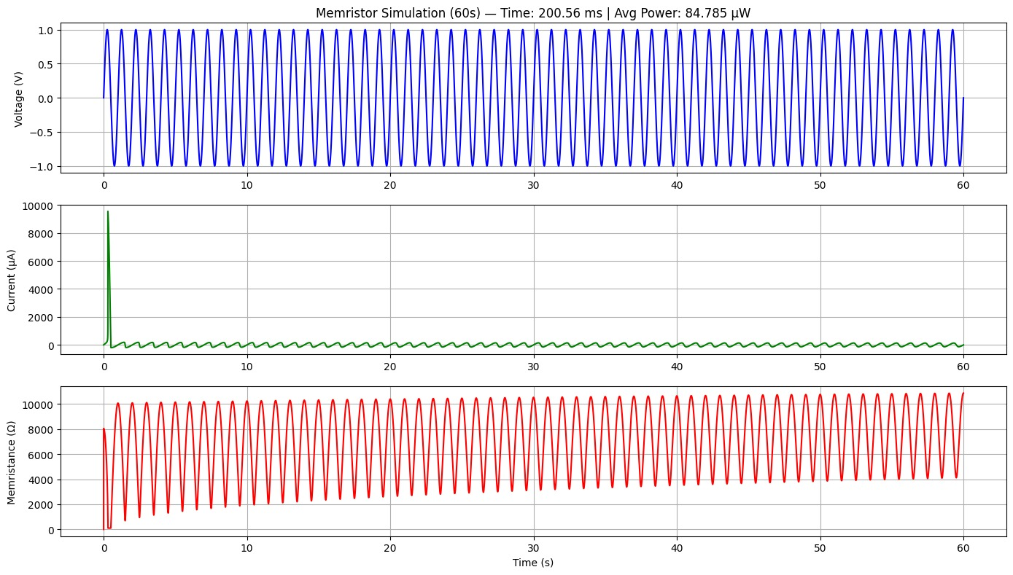
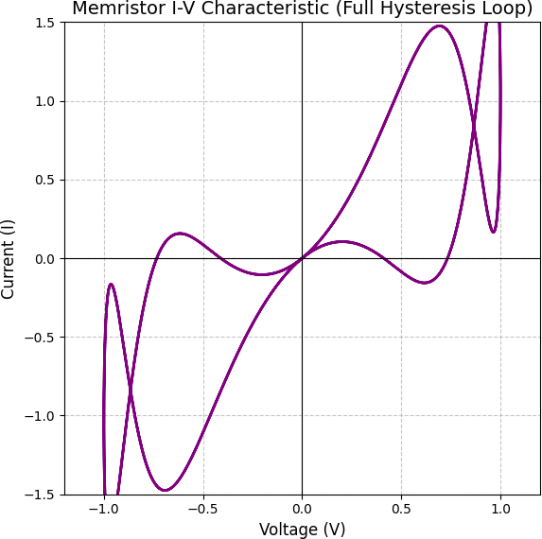
Implementation & Simulation

Slide 10
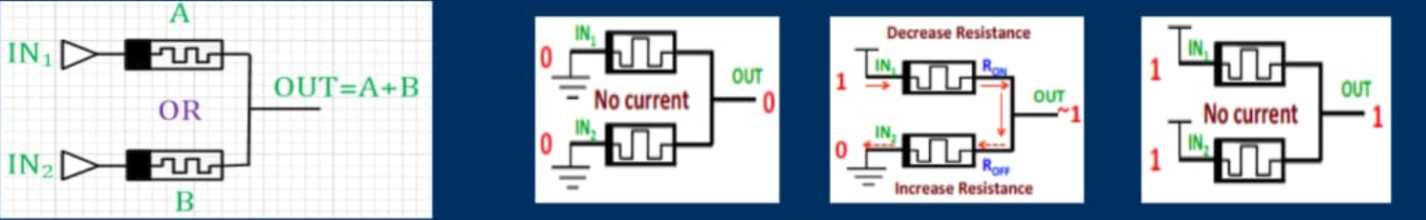
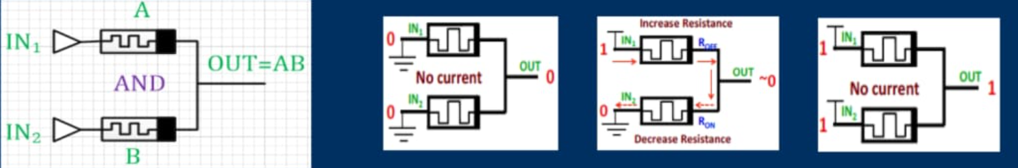
Memristor Ratio Logic[4]

Slide 11
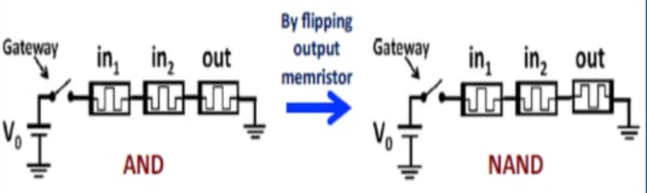
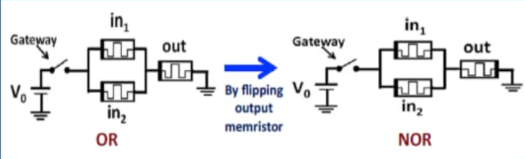
Magic Logic[5] (Initialize the output memristor to logic 0 state for positive Gates(AND , OR) & logic 1 for negative Gates(NAND, NOR, NOT)

Slide 12
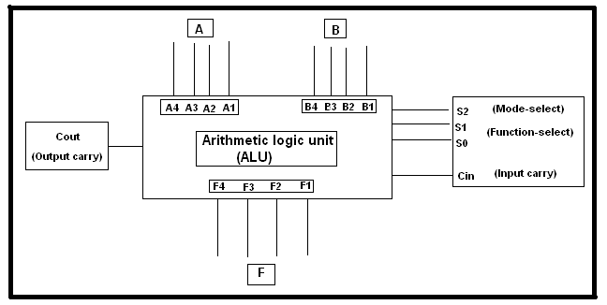
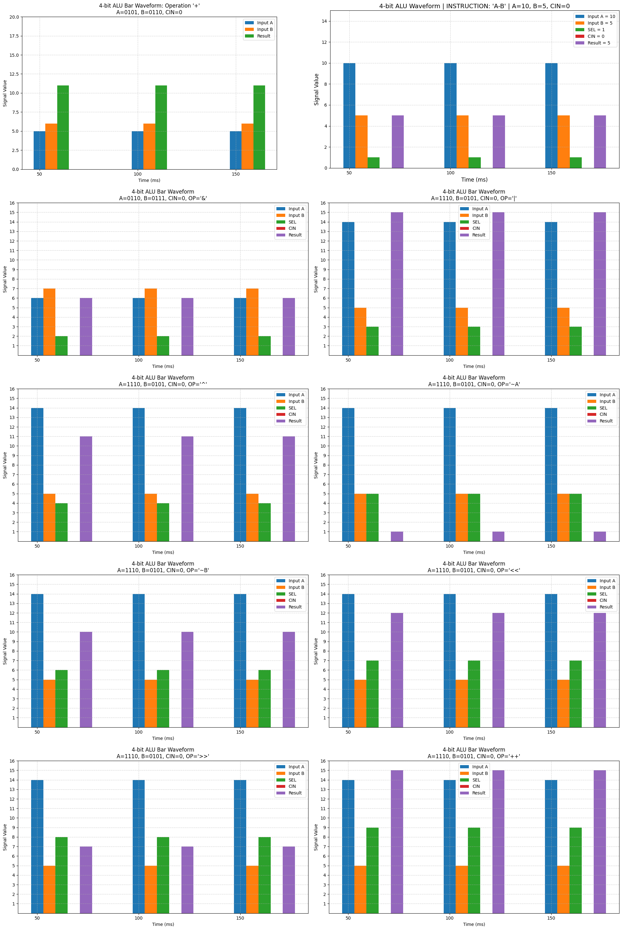
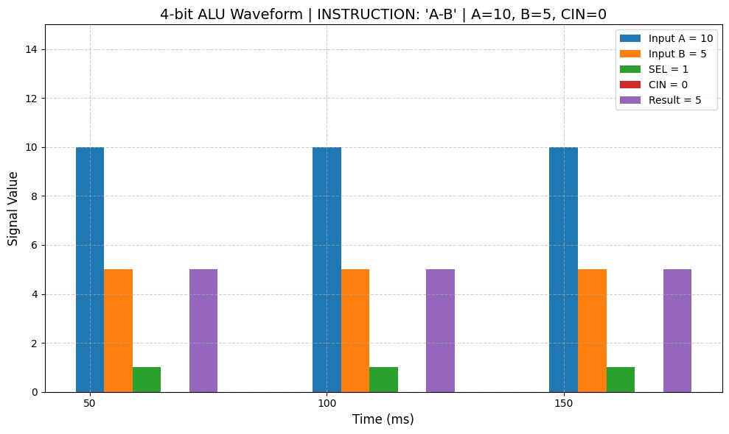
Functional Table
Operation | Symbol | SEL code (4-bit) | Function | Carry / Flag (if applicable) | Description
Addition (A + B + CIN) | + | 0000 | (A+B+CIN) % 16 | Carry if overflow | Adds A and B with optional CIN
Subtraction (A - B - CIN) | - | 0001 | (A-B-CIN) % 16 | Flag = 1 if negative | Subtracts B from A with CIN
AND | & | 0010 | A & B | 0 | Bitwise AND
OR | | | 0011 | A | B | 0 | Bitwise OR
XOR | ^ | 0100 | A ^ B | 0 | Bitwise XOR
NOT A | ~A | 0101 | ~A % 16 | 0 | Bitwise complement of A
NOT B | ~B | 0110 | ~B % 16 | 0 | Bitwise complement of B
Left Shift A | << | 0111 | (A << 1) % 16 | 0 | Shifts A left by 1 bit
Right Shift A | >> | 1000 | A >> 1 | 0 | Shifts A right by 1 bit
Increment A | ++ | 1001 | (A+1) % 16 | Carry if overflow | Increments A by 1
Decrement A | -- | 1010 | (A-1) % 16 | Flag = 1 if negative | Decrements A by 1
Clear (Zero) | 0 | 1011 | 0000 | 0 | Forces result to 0
Set (One) | 1 | 1100 | 1111 | 0 | Forces result to 15 (all bits 1)
Pass A | A | 1101 | A | 0 | Passes A directly
Pass B | B | 1110 | B | 0 | Passes B directly
Equality (A == B) | == | 1111 | 1 if A==B, else 0 | 0 | Compares A and B
S4
(s)

Slide 13
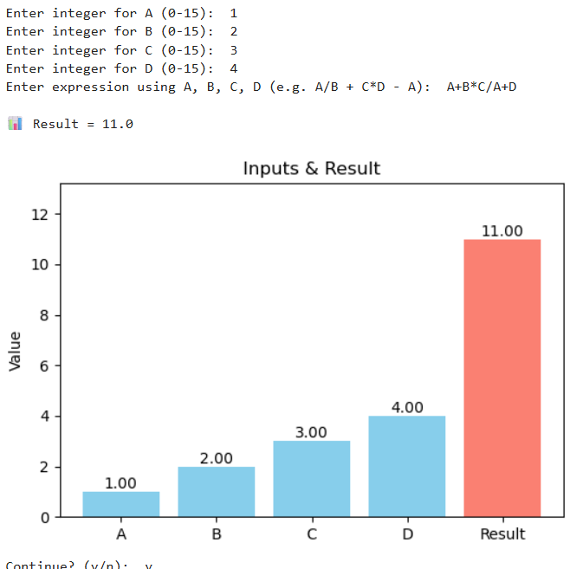
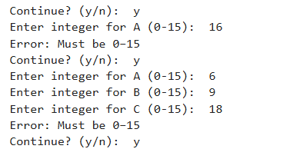
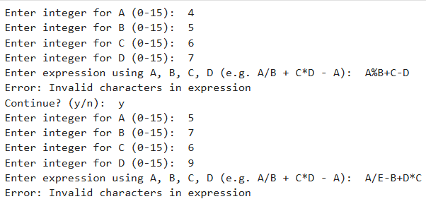
Real Time Operation
User Define Operation
For Wrong Input
For Wrong Character

Slide 14
Future Work[6]
1) Scale to higher bit-widths with precision support
3) Implement crossbar-based in-memory computing
5) Hardware‑AI co‑design & emulation
2) Integrate neuromorphic capabilities
4) Material and device model diversification

Slide 15

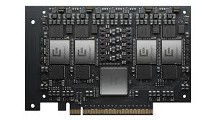


Areas of Application[7]
(1)
(2)
(3)
(4)
Brain-Inspired
AI
In-Memory AI Acceleration
Edge and IoT Intelligence
Hardware Security & R-based Logic

Slide 16

Conclusion
4-bit memristor-based system was successfully implemented and tested for 16 arithmetic and logic operations. A basic user-interactive calculator was built to perform these operations, demonstrating the efficiency and potential of memristor logic in computational tasks. Future work may focus on scaling the system to higher-bit architectures, integrating AI-based decision-making, and optimizing memristor performance for real-time, low-power computing in advanced processors and neuromorphic systems.

Slide 17
Reference
Leon Chua. Memristor-the missing circuit element. IEEE Transactions on circuit theory, 18(5):507–519, 1971.
Dmitri B Strukov, Gregory S Snider, Duncan R Stewart, and R Stanley Williams. The missing memristor found. nature, 453(7191):80–83, 2008.
A. Kumar, B. Kumawat and N. Pandey, "Design of 4-bit ALU using TEAM Memristor Model and CMOS Logic," 2020 International Conference on Communication and Signal Processing (ICCSP), Chennai, India, 2020, pp. 0956-0961, doi: 10.1109/ICCSP48568.2020.9182450.
X. Lian et al., "Realization of Complete Boolean Logic and Combinational Logic Functionalities on a Memristor-Based Universal Logic Circuit," in Chinese Journal of Electronics, vol. 33, no. 5, pp. 1137-1146, September 2024, doi: 10.23919/cje.2023.00.091
S. Kvatinsky et al., "MAGIC—Memristor-Aided Logic," in IEEE Transactions on Circuits and Systems II: Express Briefs, vol. 61, no. 11, pp. 895-899, Nov. 2014, doi: 10.1109/TCSII.2014.2357292.
"Memristors: From Materials to Devices: Memristor Models, Mechanisms, Fabrication Methods, and Applications," in Memristors: From Materials to Devices: Memristor Models, Mechanisms, Fabrication Methods, and Applications , River Publishers, 2025, pp.i-x.
Z. Mustaqueem, A. Quaiyum Ansari and M. W. Akram, "Robust and potential applications of memristors," 2023 International Conference on Power, Instrumentation, Energy and Control (PIECON), Aligarh, India, 2023, pp. 1-6, doi: 10.1109/PIECON56912.2023.10085896.

Slide 18

Thank You
……..

